Slide 1
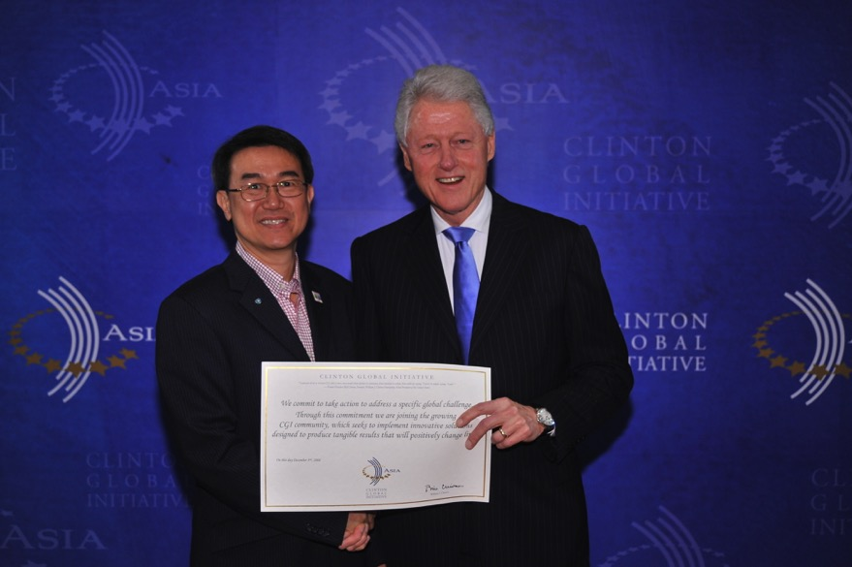
COMMITMENT WITH PRESIDENT CLINTON

Slide 3
OUR VISION - END POVERTY TOGETHER THROUGH EFFECTIVE COLLABORATION
Governments
Foundations
Social Entrepreneurs
NGOs
MNCs & SMEs
International Forums
Development banks
UN Groups
Universities
Notes:
Gears come in machine part
We want to put in the gears and grease to get the development machine running

Slide 4

REDUCE IDEAS WASTE
4,000 Social Entrepreneurs have proven innovative BOP solutions.
Thousands of corporations have interests in BOP.
Reuse and Recycle Proven Solutions for Scalability

Slide 5



SYNAPSE WHEEL
ACADEMIC/RESEARCH
INSTITUTIONS
GOVERNMENTS
AGRICULTURE
ENERGY
COMMUNITIES
FARMER
COLLECTIVES
HYDROPOWER
DRIP-IRRIGATION/
Organics
BIOFUEL
INVESTORS
SOLAR
BANKING
POVERTY STOPLIGHT SURVEY
SOCIAL
ENTERPRISES
Needs assessment survey
ICT
MICRO-FINANCE
INSTIUTIONS
MOBILE TECH
FINANCE
FUNDACIÓN PARAGUAYA’S
E-COMMERCE
IMPACT
INVESTMENTS
ENTERTAINMENT
Community
HEALTH & WELLBEING
KEY SECTORS
LAST-MILE
DISTRIBUTION
SANITATION
INFRASTRUCTURE
GLOBAL HEALTH
LOGISTICS
MULTI-NATIONAL
CORPORATIONS
SMEs
WATER
WORKFORCE
MGMT
KEY STAKEHOLDERS
PRIMARY
LAND RIGHTS
SECONDARY
CONSTRUCTION
TECH
VOCATIONAL
AID AGENCIES
EDUCATION
HOUSING
PHILANTHROPIC
FOUNDATIONS

Slide 6
3 + 3 + 3 = 9
3 X 3 X 3 = 27
3 ^ 3 ^ 3 = 19,683
SYNERGY FROM COLLABROATION

Slide 7
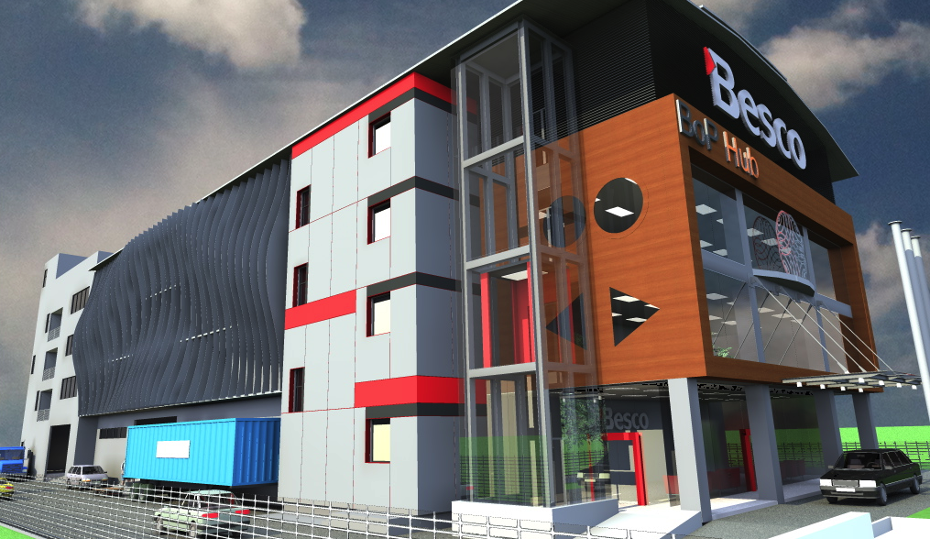
NEXT TO UBI MRT
SINGAPORE
BOP HUB Design Center 65,000 sq ft
World Trade Center for the Poor.

